Slide 1
demo

Slide 2
display: none,block,inline
visibility: hidden,visible

Slide 3
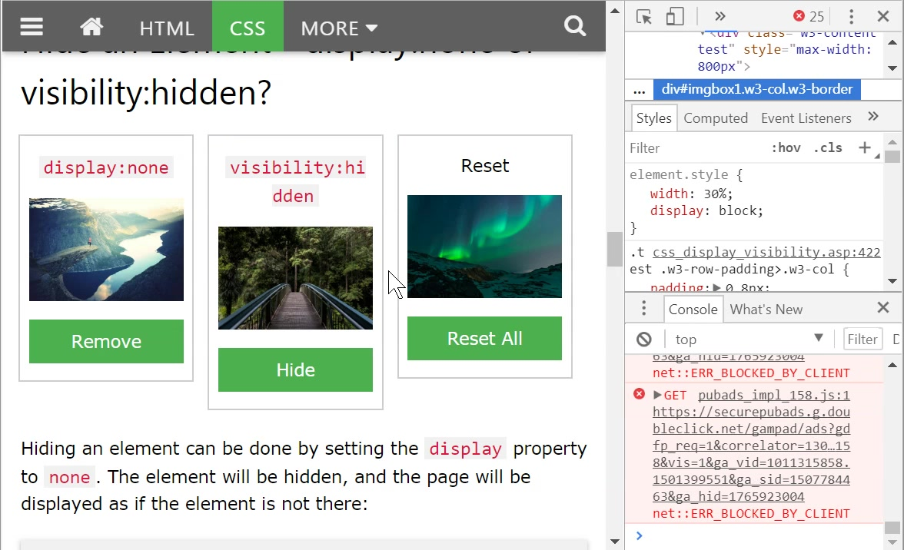
網站

Slide 4
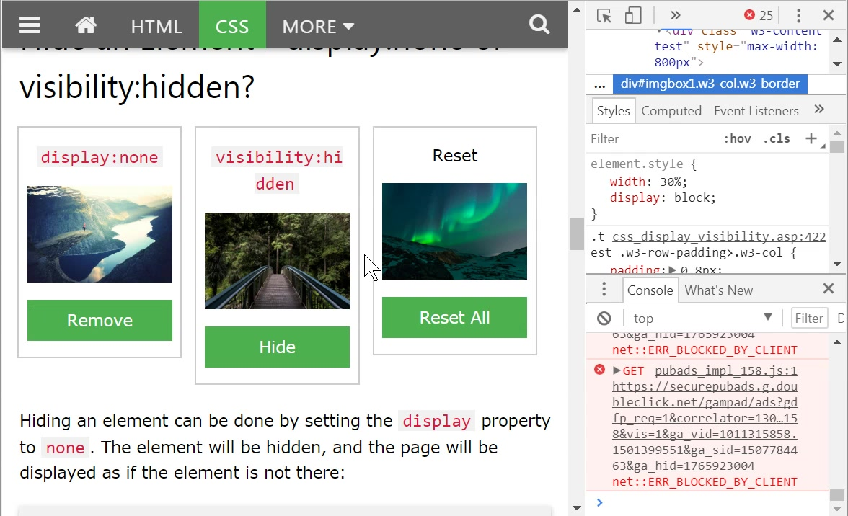

Slide 5
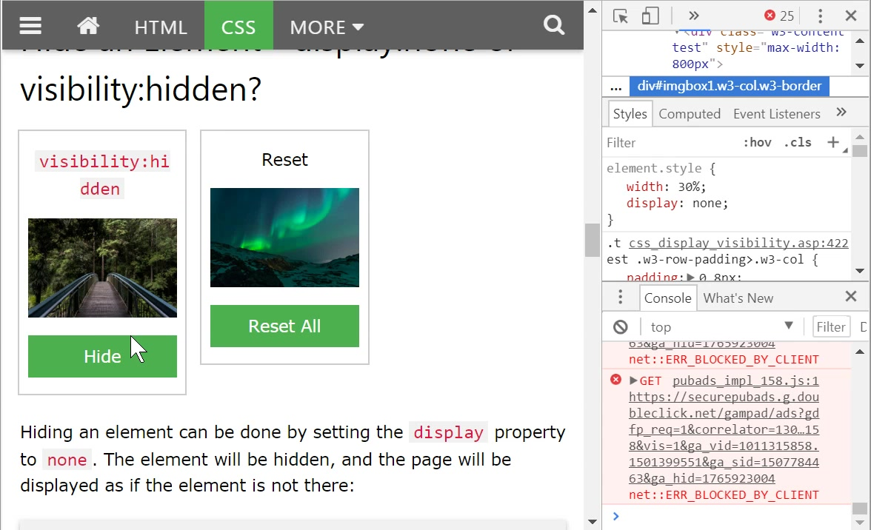

Slide 6
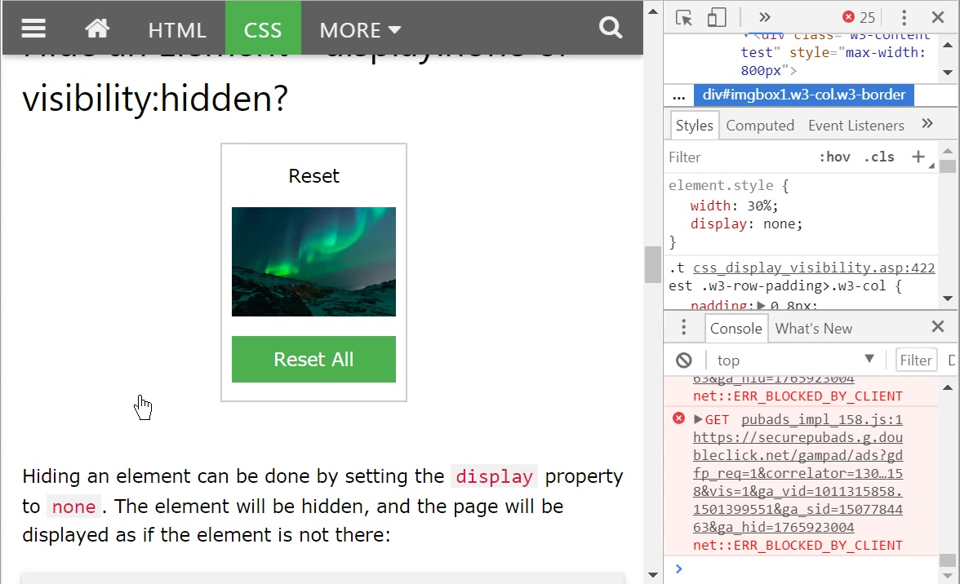

Slide 7
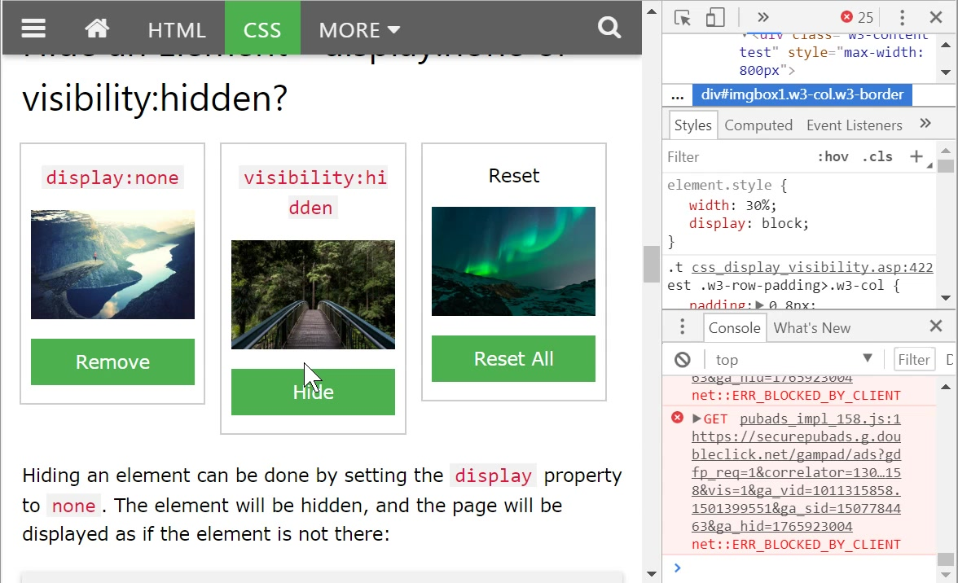

Slide 8
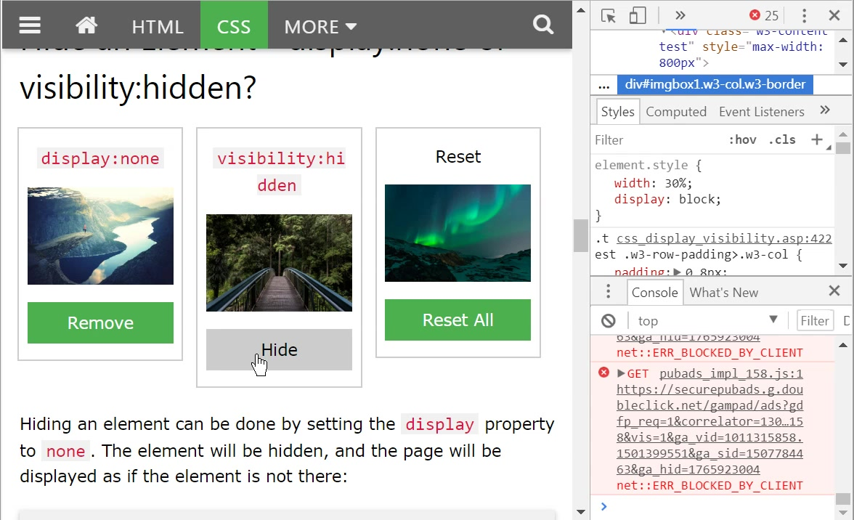

Slide 9
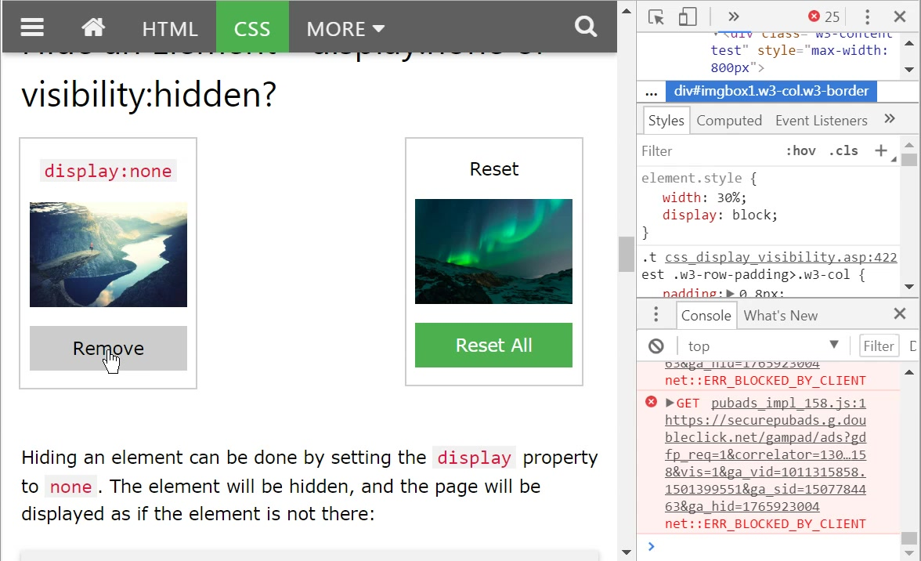

Slide 10
從網站複製要分析的html
除了複製，順便刪掉不要的HTML
然後再加入測試HTML

Slide 11
<script>
function removeElement() {
document.getElementById("imgbox1").style.display = "none";
}
function changeVisibility() {
document.getElementById("imgbox2").style.visibility = "hidden";
}
function resetElement() {
document.getElementById("imgbox1").style.display = "block";
document.getElementById("imgbox2").style.visibility = "visible";
}
</script>
<div style="margin:20 "> <!-- 試試0 -16px 看看 -->
<div style="display:inline"> this is a div 1.</div>
<div style="display:inline"> this is a div 2.</div>
</div>
<div id="imgbox4" style="width: 30%;display:inline">
<img src="img_fjords.jpg" width="200px" alt="Klematis">
</div>
<div style="width: 30%;display:inline; " id="imgbox5">
<img src="img_forest.jpg" width="200px" alt="Klematis">
</div>
<div style="width:30%;;display:inline;">
<img src="img_lights.jpg" width="200px" alt="Klematis">
</div>
<hr>
<div id="imgbox1" style="display:inline">
<p >display:none</p>
<img src="img_fjords.jpg" width="200px" alt="Klematis">
<p><button onclick="removeElement()">Remove</button></p>
</div>
<div style=" display:inline;visibility: visible" id="imgbox2">
<p > visibility:hidden </p>
<img src="img_forest.jpg" width="200px" alt="Klematis">
<p><button onclick="changeVisibility()">Hide</button></p>
</div>
<div style="display:inline">
<p>reset</p>
<img src="img_lights.jpg" width="200px" alt="Klematis">
<p><button onclick="resetElement()">Reset All</button></p>
</div>

Slide 12
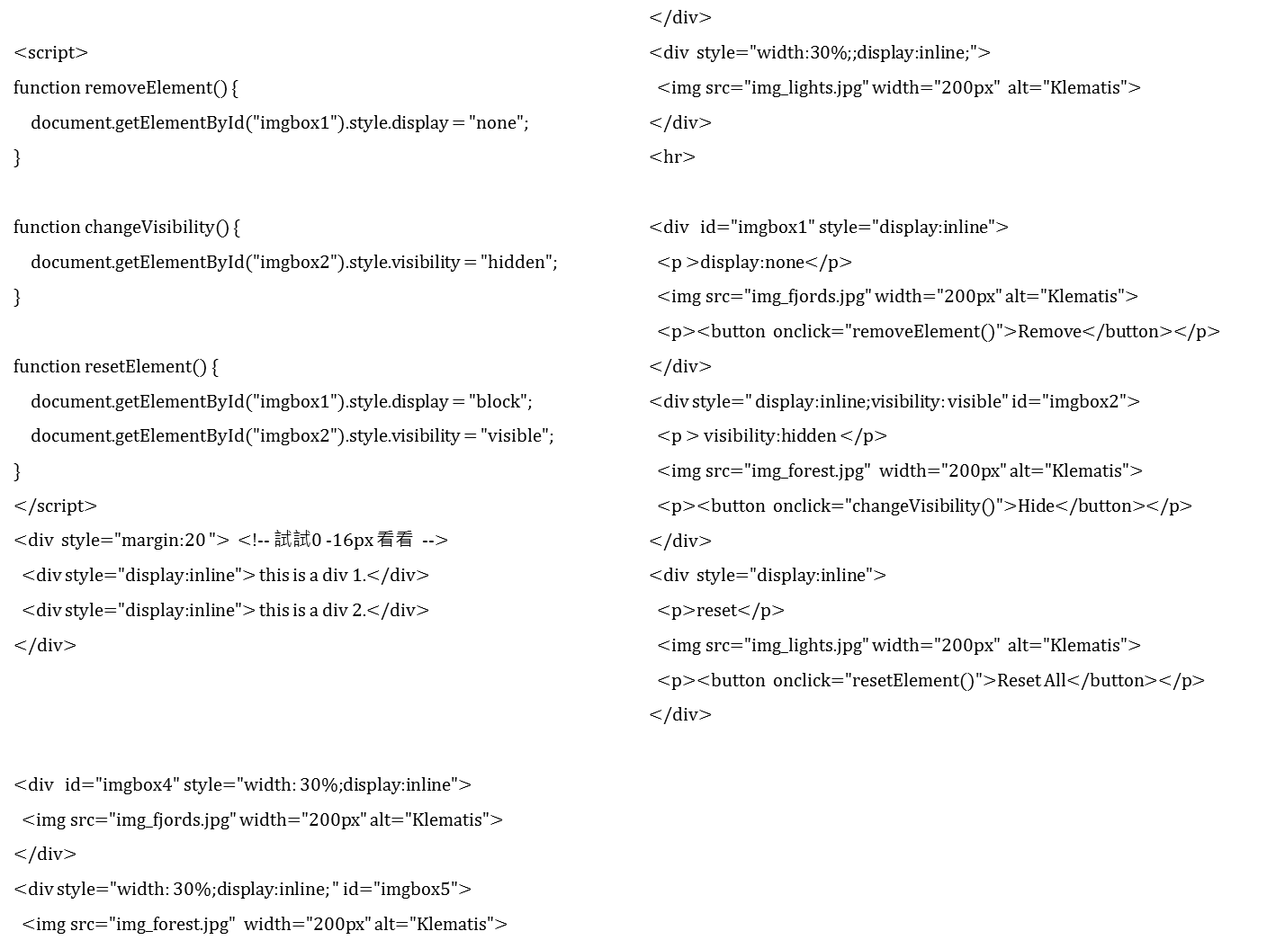
複製並刪除多餘HTML
因為我們的實驗直接將style寫在標籤的attribute:style

Slide 13
測試2
測試1

Slide 14
display:inline
紅色方框表示都已經標為inline
但是結果仍然有換行
這是因為有<p> 的存在，綠色
這也是hr 之上，和之下的不同點

Slide 15
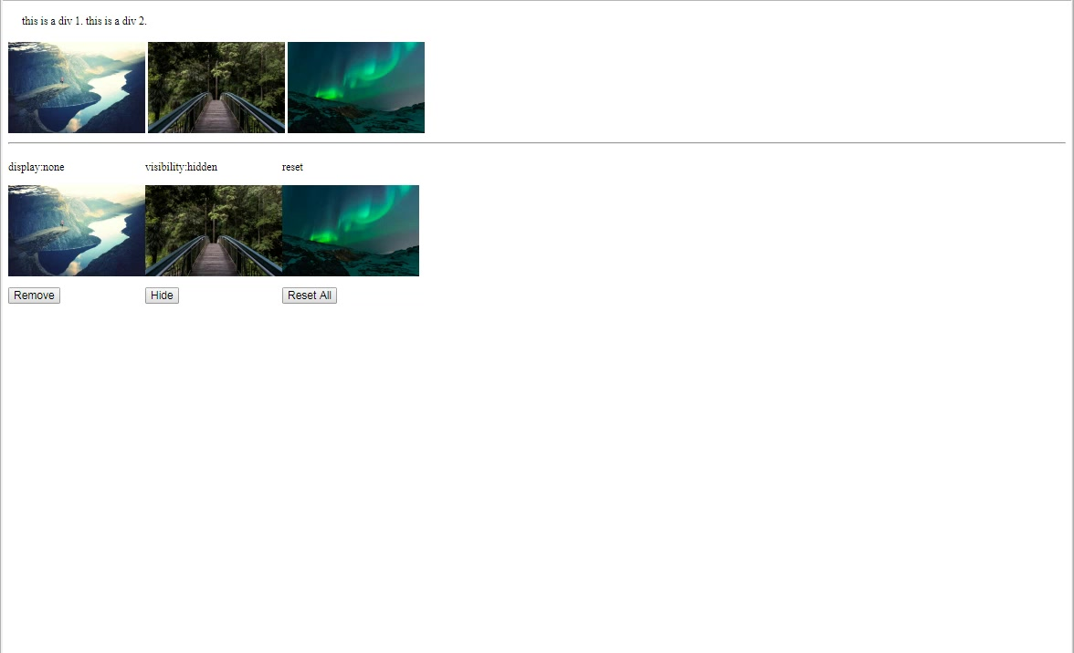
預期是這樣

Slide 16
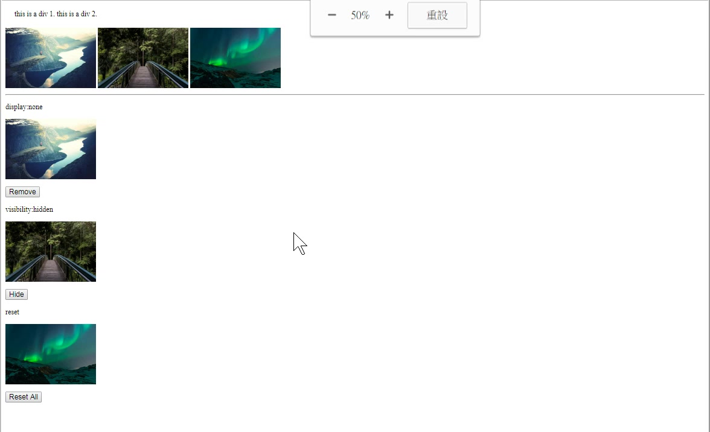
但是結果是這樣

Slide 17
分析

Slide 18
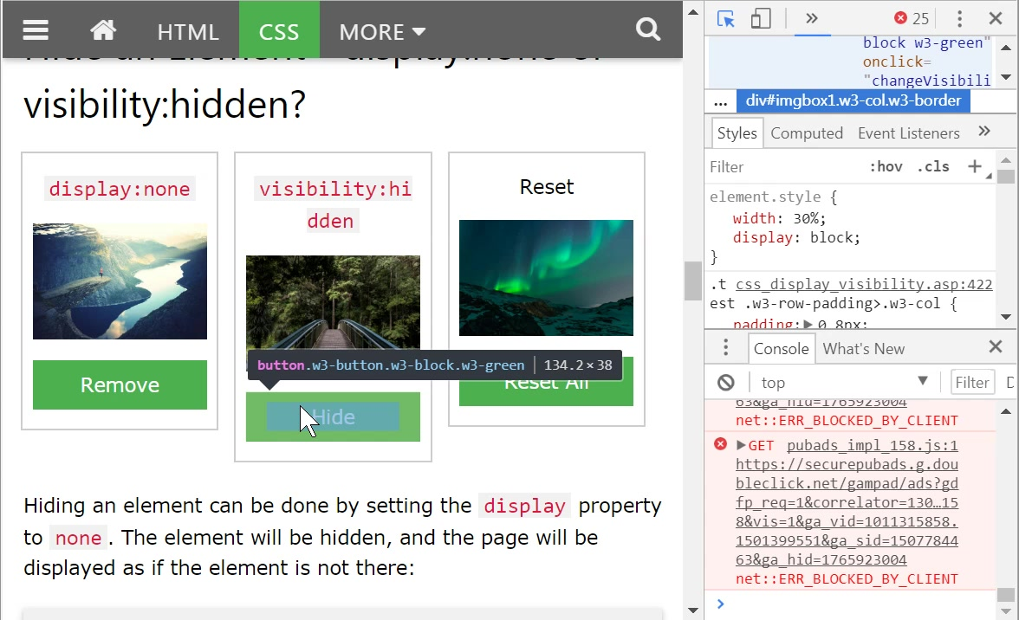

Slide 19
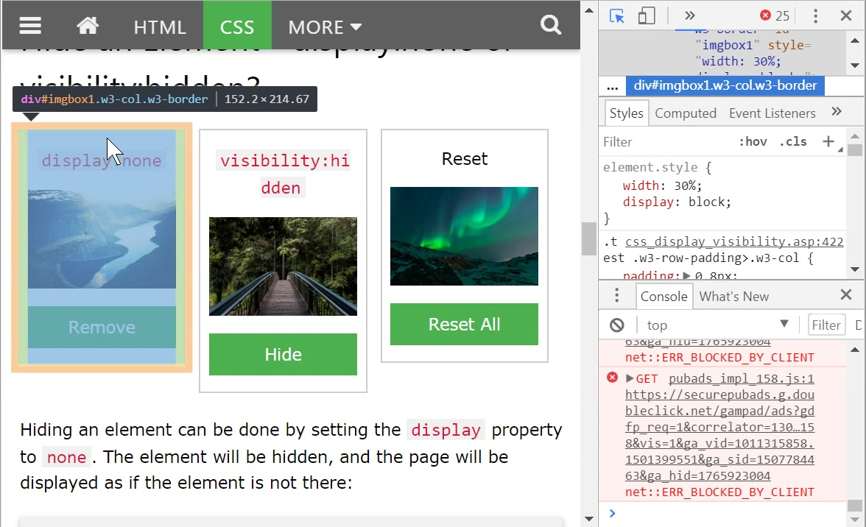

Slide 20
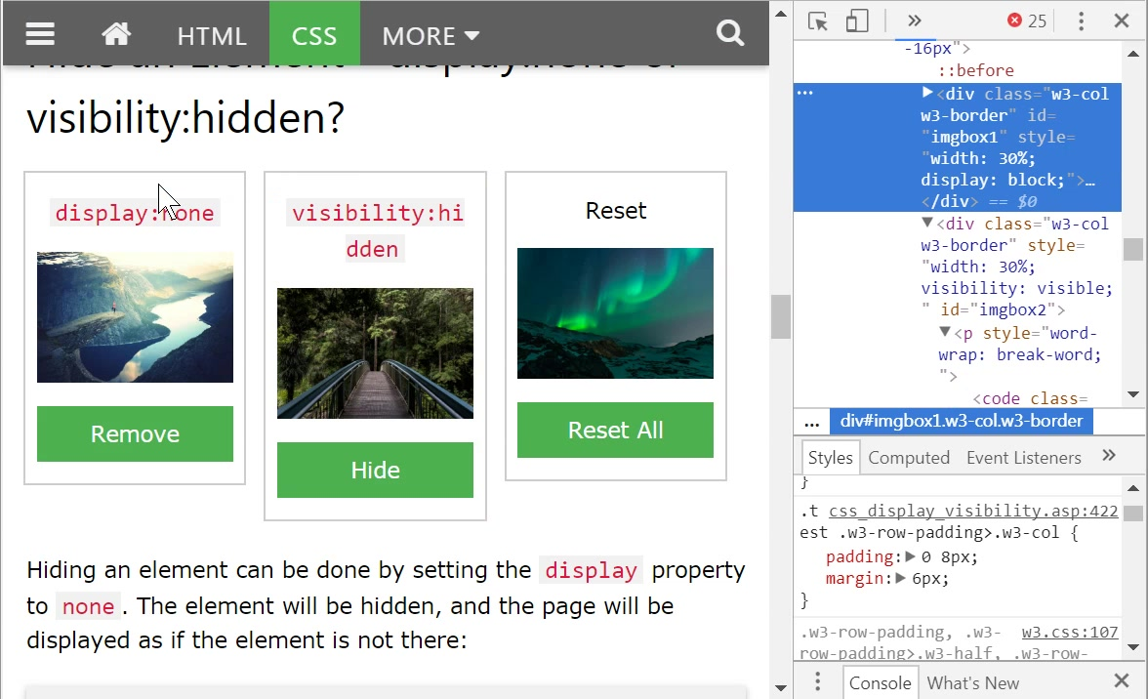

Slide 21


Slide 22
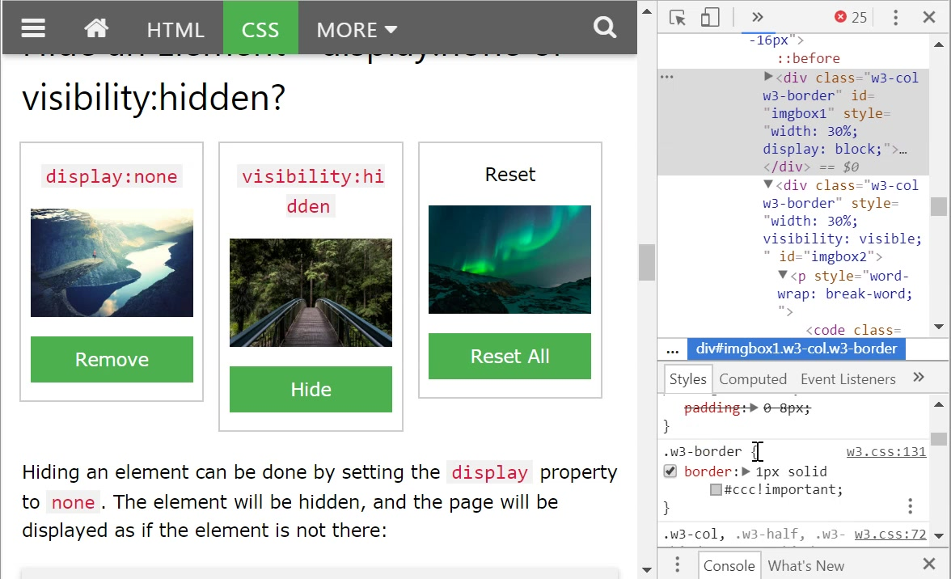

Slide 23
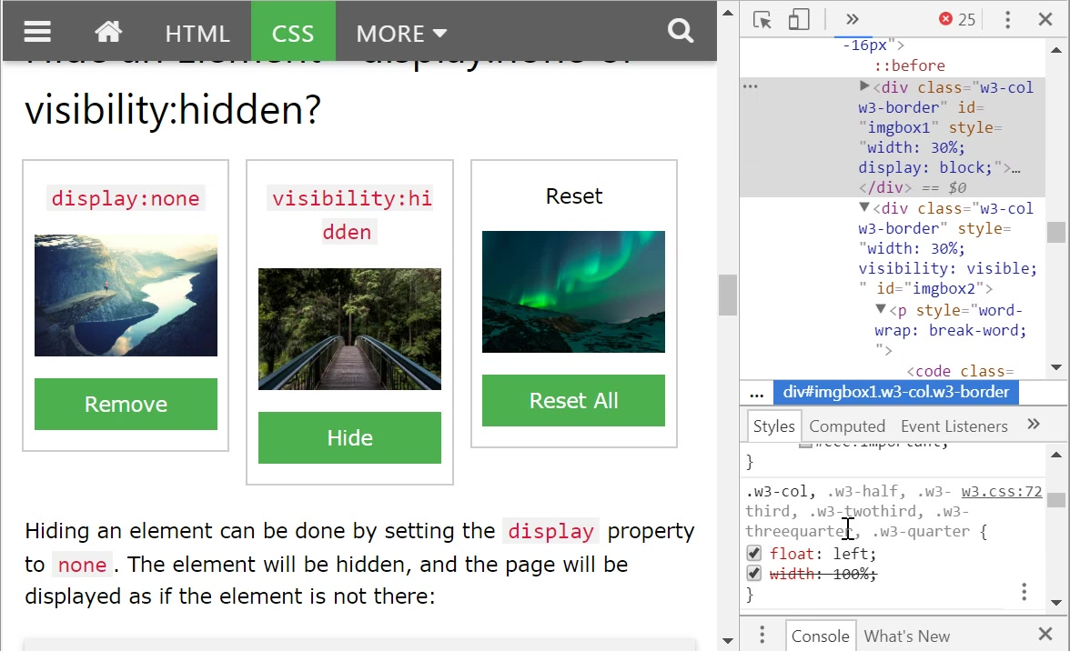

Slide 24
修正

Slide 25
<script>
function removeElement() {
document.getElementById("imgbox1").style.display = "none";
}
function changeVisibility() {
document.getElementById("imgbox2").style.visibility = "hidden";
}
function resetElement() {
document.getElementById("imgbox1").style.display = "block";
document.getElementById("imgbox2").style.visibility = "visible";
}
</script>
<div style="margin:20 "> <!-- 試試0 -16px 看看 -->
<div style="display:inline"> this is a div 1.</div>
<div style="display:inline"> this is a div 2.</div>
</div>
<div id="imgbox4" style="width: 30%;display:inline">
<img src="img_fjords.jpg" width="200px" alt="Klematis">
</div>
<div style="width: 30%;display:inline; " id="imgbox5">
<img src="img_forest.jpg" width="200px" alt="Klematis">
</div>
<div style="width:30%;;display:inline;">
<img src="img_lights.jpg" width="200px" alt="Klematis">
</div>
<hr>
<div id="imgbox1" style="display:inline;float:left">
<p >display:none</p>
<img src="img_fjords.jpg" width="200px" alt="Klematis">
<p><button onclick="removeElement()">Remove</button></p>
</div>
<div style=" display:inline;visibility: visible;float:left" id="imgbox2">
<p > visibility:hidden </p>
<img src="img_forest.jpg" width="200px" alt="Klematis">
<p><button onclick="changeVisibility()">Hide</button></p>
</div>
<div style="display:inline;float:left">
<p>reset</p>
<img src="img_lights.jpg" width="200px" alt="Klematis">
<p><button onclick="resetElement()">Reset All</button></p>
</div>

Slide 26
其他測試

Slide 27
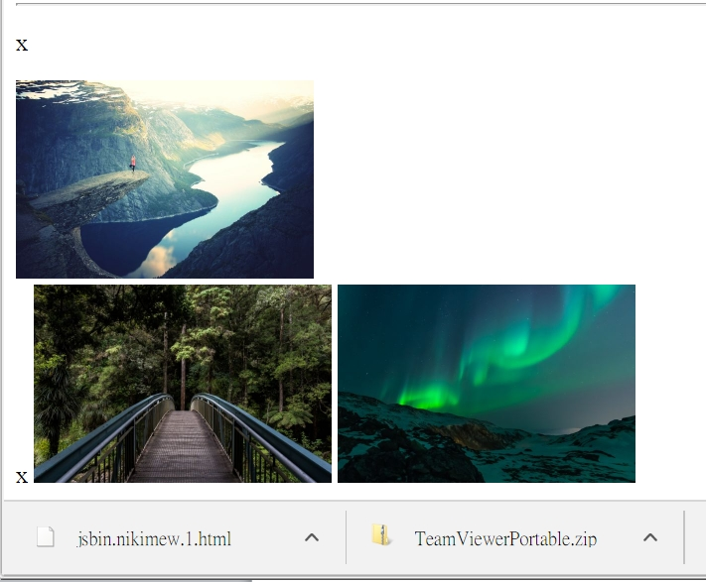
div
<div id="imgbox1" style="display:inline">
<p>x</p>
<img src="img_fjords.jpg" width="200px" alt="Klematis">
<br>
<p style="display:inline;">x</p>
</div>
<p style="width:30%">x</p>

Slide 28
利用float: left 可以簡單解決問題
<div id="imgbox1" style="float:left">
<img src="img_fjords.jpg" width="200px" alt="Klematis">
<br>
<p >x</p>
</div>
<div style="float:left" id="imgbox2">
<img src="img_forest.jpg" width="200px" alt="Klematis">
</div>
<div style="float:left">
<img src="img_lights.jpg" width="200px" alt="Klematis">
</div>

Slide 29
更多
<div tutorial >

